Slide 1

NASI SPONSORZY I PARTNERZY

Slide 2
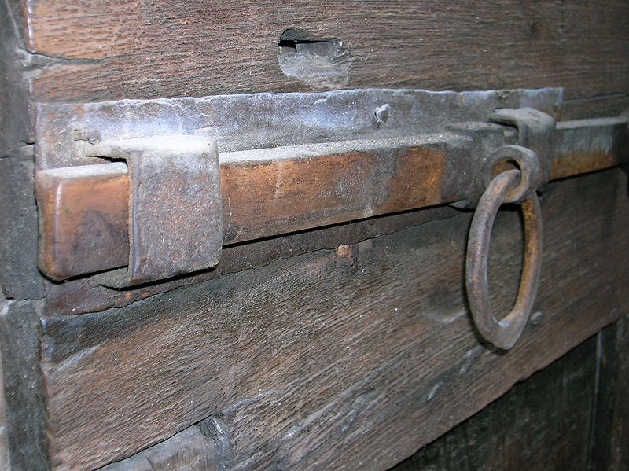
Inside SQL Server Latches
Validated for SQL Server 2014
Bob Ward
Principal Architect
Microsoft Corporation
bobward@Microsoft.com

Slide 3
What is a Latch?
Introduced in SQL 7.0 for database pages
It’s all about “physical” protection
Ownership and Waiters
Compatibility Matrix (Modes)
Thread synchronization for important data structures or concurrency sensitive code
Not directly under user control
No isolation level or transaction semantics
EX, SH, ….
There is no latch hint

Slide 4
Why do I Care?
Factors under your control can affect visibility and behavior of latches
Your application
Your design and configuration
Throughput of I/O system
You will see latches in…
sys.dm_os_wait_stats
sys.dm_os_latch_stats
sys.dm_exec_requests
sys.dm_os_waiting_tasks
Perfmon Counters
Errors (Latch Timeout)
XEvents
dbcc sqlperf (‘<DMV>’, clear)
Notes:
DEMO1
QUESTION FOR AUDIENCE: Does anyone know why it is important to look at sys.dm_os_waiting_tasks in some cases?

Slide 5
OK, What is it really?
64bit
C++ class
waiters
List of waiters
owner
count
class
Task address of owner
This is the “latch”
Latch class (latch id)
SOS Event to wait
+0
+8
+16
+24
63
36
35
12
11
5
4
3
2
1
0
Num KP
Num SH
Stuff
Spnlck
Wait
DT
EX
UP
Count of
KP latches
Count of
SH latches
superlatch
and other stuff
spinlock
waiters
exist
DT latch held
EX latch held
UP latch held

Slide 6
Latch Compatibility
mode
DT
Destroy Latch; Heaviest of all
Ex. Removing buffer from cache
SH
UP
EX
Just reading. No ownership tracking
Readers are ok but no one writes
It’s all mine, but I’m tracked
KP
Keep Latch; Very light – just peeking
“Reference” count
 | KP | SH | UP | EX | DT
KP | Y | Y | Y | Y | N
SH | Y | Y | Y | N | N
UP | Y | Y | N | N | N
EX | Y | N | N | N | N
DT | N | N | N | N | N
Y turns to N if waiters
owner
waiters
Not always FIFO
EX
SH
EX
SH
These can go at once
Notes:
The order of list of modes is not a coincidence
Y turns to N if waiters. If the current owner is UP and the first waiter is EX, a SH is not granted immediately. It must wait for the UP latch to be released. This is because in general we use FIFO waiting except…..
But….not always FIFO because we may grant someone a latch down in the list if compatible with the head of the list. For example, if a EX latch was released and the next one on the list is SH latch but 2nd is EX and 3rd is SH, we will grant the 3rd SH access along with the first. We take care of starvation as you always bump up one in the list and eventually make it to the head.

Slide 7
The BUFFER (BUF) Latch
BUF
BUF is 156 bytes in 2008R2+
SH for reading
UP and EX for writing
KP for traversing
DT for freeing
PAGELATCH_XX or PAGEIOLATCH_XX
bpage
bpageno
ptr
bstat
blog
value
52 bytes
blatch
Latch class
PAGE (in cache)
BUF_ONLRU | 0x000001
BUF_DIRTY | 0x000002
BUF_IO | 0x000004
BUF_HASHED | 0x000008
BUF_READ | 0x000400
BUF_IOERR | 0x000800
m_headerversion
m_pageid
Notes:
blog is a kind of tracing mechanism against the buffer (freed, deallocated, stiolen, …)
This structure has changed since SQL 2008 regarding the gap between blog and blatch. (40 bytes in 2008R2 now 52 bytes for 2012) but the size of the BUF class is the same at 156 bytes since
2008R2.
DEMO2

Slide 8
Why aren’t locks enough?
Some page changes are just in header (Ex. Checksum, torn page bits)
INSERT VALUES (3,300)
Page 100
Page 100
IX Page 100
EX_LATCH
m_freedata=126
141
m_freedata=126
156
1
100
2
200
3
1
100
2
200
4
300
400
4
400
INSERT VALUES (4,400)
111
96
EX_LATCH
141
126
111
96
IX Page 100

Slide 9
I Thought it was an I/O thing?
For RG I/O, SQL throttles async I/O so could inflate latch wait
Database file
Worker Thread Y
Page 1:100
Page 1:100
Acquire EX_LATCH on buffer
Submit aysnc I/O request
Acquire SH_LATCH on buffer
I/O completion routine executed
EX_LATCH released
SH_LATCH acquired
PAGEIOLATCH_SH Wait
Page not in cache
Get Page 1:100
Scan Table X
Worker Thread X

Slide 10
Latches and Tempdb
PFS, SGAM, GAM
The heaviest latch contention in tempdb is for allocation
Because everyone usually wants to allocate/deallocate frequently
What would the symptoms look like for this type of contention?
How do you “ease” the contention?
Add more files (same size and properties)
How many? (See Inside Tempdb from PASS 2011)
Use trace flag 1118
If you finally get past all of this, system table pages could get in your way
I/O delays can lead to PAGEIOLATCH on any page
Make sure you are using temp table caching
PAGELATCH_XX 2:<n>:<alloc page>
System Center Advisor alerts if 1 file and > 1 CPUs
You may just need to redesign tempdb usage
Notes:
DEMO3

Slide 11
Let’s talk Non-BUF latches
Why not just reuse the BUF latch concept?
Shows up as LATCH_XX in DMVs.
wait_resource is the type (class) and mem address of latch
Other wait_types are not latches (Ex. ASYNC_NETWORK_IO, CXPACKET, …).
Sys.dm_os_latch_stats to see all of them
162 in SQL 2014
They use concurrency but not a latch class
Notes:
EXAMPLE LATCHES IN SQL 2014 not IN SQL 2012
ASYNC_TRANSPORT_MULTI_SESSION
COLUMNSTORE_LOAD_METADATA
COLUMNSTORE_ROWGROUP_COLLECTION
XFCB_CREDENTIAL
XFCB_CREDENTIAL_MANAGER

Slide 12
Here are a few to think about
NESTING_TRANSACTION_FULL
FGCB_ADD_REMOVE
LOG_MANAGER
ACCESS_METHODS_DATASET_PARENT
RCSI and parallel queries
Autogrow of data files
Autogrow of tlog
ALLOC_FREESPACE_CACHE
Only seen during parallel queries
ALLOC_EXTENT_CACHE
Partition your table
Partition your table

Slide 13
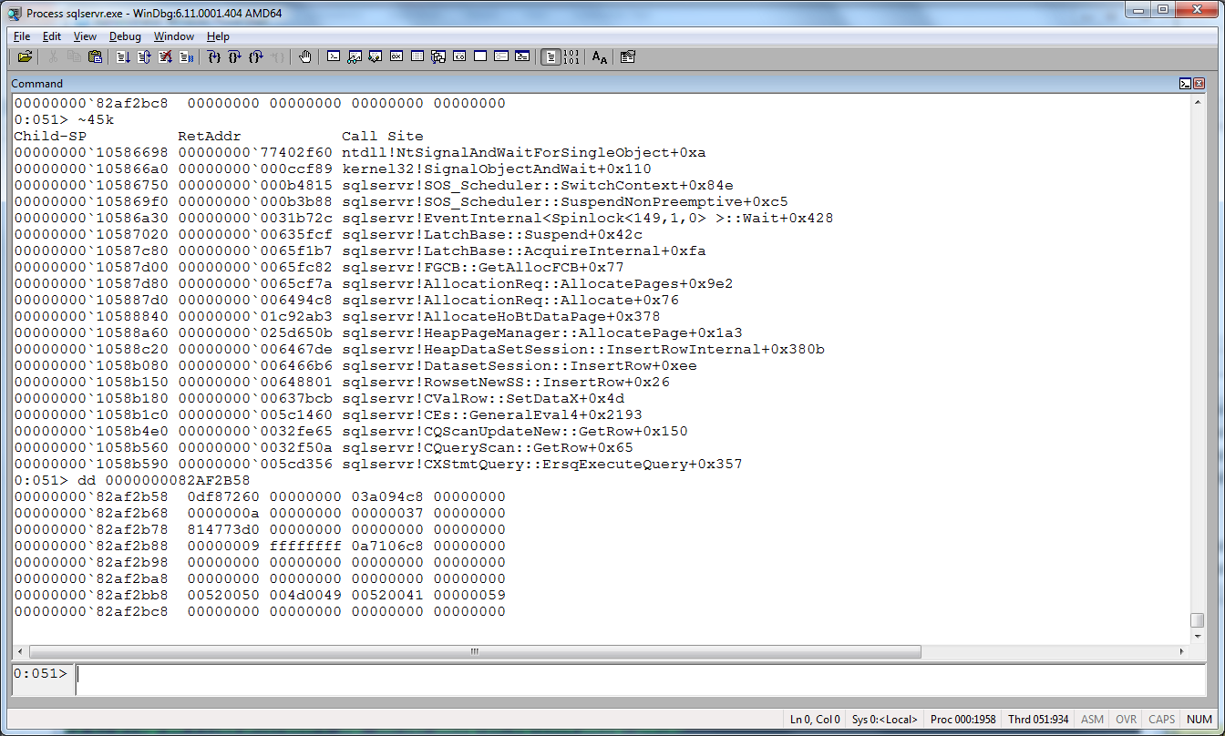
Demo
Let’s debug
a latch
Notes:
DEMO5

Slide 14
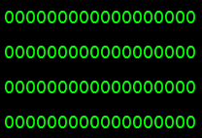
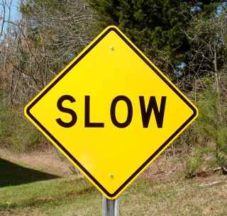
Inside the FGCB_ADD_REMOVE latch
SQL Server Engine
INSERT
“I need to grow” LATCH_EX: FGCB_ADD_REMOVE
Need space
INSERT
mydb.mdf
Need space
FGCB
Autogrow
INSERT
Need space
Moral of the story: Use instant file initialization but…it doesn’t work for the tlog
Need space
INSERT
LATCH_SH: FGCB_ADD_REMOVE

Slide 15

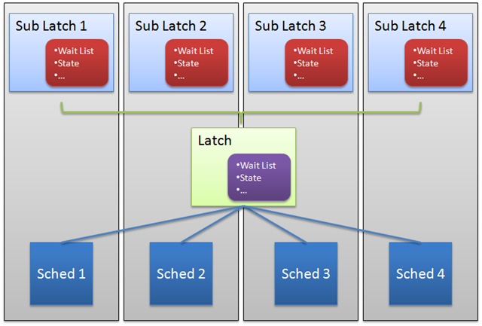
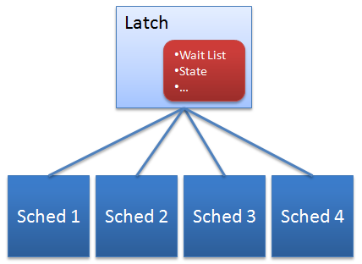
SuperLatches
See the Robert Dorr blog post
latch_promoted XEvent
and sys.dm_os_sublatches
Notes:
Used mostly with BUF latches but also used a few other places

Slide 16
Latch Timeouts
5 minutes
Latch timeout warnings and errors
Msg 845: BUF latch error raised to client (and we are no longer waiting)
Msg 847: Non-BUF latch timeout (always wait)
Stack dump on timeout warnings
Deadlatch
Limits
Msg 844: BUF latch timeout warning in ERRORLOG but we keep waiting
Msg 846: BUF latch timeout warning in ERRORLOG (before we raise 845)
Hang
We’ve typically seen these as a self-deadlatch
FGCG_ADD_REMOVE and PAGEIOLATCH excluded
Critical code such as rollback
mini but includes what we need
Not your fault
owner=waiter but not I/O
Notes:
DEMO6

Slide 17
Is your latch causing you a problem?
What is the avg disk transfer rate?
PAGEIOLATCH waits = I/O bottleneck
Customers call me when this in the “seconds” range
Not always a high count for a problem
High PAGELATCH waits mean “hot” pages
Unless a bug it is usually allocation pages (and usually tempdb)
Could be system table pages for DDL
Non-BUF latch waits depends on the latch class
Find out the “hot” class and see if one of generally known issues (Ex. Autogrow)
Latch timeouts
This is just bad no matter what type (5 minute wait)
Could be inserts into clustered identity key
Check sys.dm_db_index_operational_stats for BUF latch wait stats per index

Slide 18
BONUS: What is a spinlock?
Shared data structures needs thread protection
Windows Kernel objects are expensive (mutex, event, …)
May be cheaper to “spin” then wait
It has to be very fast (or you will kill the CPU)
SQL Server uses a bit or int to protect key shared data structures -Often a list
I thought a latch does that?
Well it does. It protects a database page or other shared data structures
And even some of the latch class members need synch
No waiters list or compat matrix. You either spin or you don’t
What do I mean by spin?
Can I see these?
sys.dm_os_spinlock_stats
We do use names to help figure out where they are used
But.. MUTEX is a common one used generically. Most famous is TOKENPERM store cache
But it has some “structure” such as compatibility and waiter lists and uses a Windows kernel object to wait
It’s a tight loop but we “backoff” after a while
XEvents spinlock_backoff

Slide 19


BONUS: The BUF latch enforcer
Trace Flag 815
LATCH_SH
BUF
scribbler
Database Page
VirtualProtect (READ_ONLY)
This can expensive
Busted! AV trying to write

Slide 20
References
How It Works: SQL Server SuperLatch'ing / Sub-latches
Q&A on Latches in the SQL Server Engine….
SQL Serve BOL on Buffer Management
SQL Server I/O Basics, Chapter 2
What is allocation bottleneck?
Inside Tempdb on PASS TV
TempDB Monitoring and Troubleshooting: Allocation Bottleneck

Slide 21

NASI SPONSORZY I PARTNERZY
Organizacja: Polskie Stowarzyszenie Użytkowników SQL Server - PLSSUG

